Slide 1

Marketing & research analytics project
- Barkha AGARWAL

Slide 2
Problem statement
An automobile parts manufacturing company has collected data of transactions for 3 years. They do not have any in-house data science team, thus they have hired you as their consultant. Your job is to use your magical data science skills to provide them with suitable insights about their data and their customers.
Auto Sales Data: Sales_Data.xlsx
DATA DICTIONARY:
ORDERNUMBER : | Order Number | CUSTOMERNAME : | customer
Quantity ordered | Quantity ordered | PHONE : | Phone of the customer
PRICEEACH : | Price of Each item | ADDRESSLINE1 : | Address of customer
ORDERLINENUMBER: | order line | CITY : | City of customer
SALES : | Sales amount | POSTALCODE : | Postal Code of customer
ORDERDATE : | Order Date | COUNTRY : | Country customer
DAYS_SINCE_LASTORDER : | Days_ Since_Lastorder | CONTACTLASTNAME : | Contact person customer
STATUS : | Status of order like Shipped or not | CONTACTFIRSTNAME : | Contact person customer
PRODUCTLINE : | Product line – CATEGORY | DEALSIZE : | Size of the deal based on Quantity and Item Price
MSRP : | Manufacturer's Suggested Retail Price | PRODUCTCODE : | Code of Product

Slide 3
contents
Agenda & Executive Summary of the data.
Exploratory Analysis and Inferences
Customer Segmentation using RFM analysis
Univariate, Bivariate, and multivariate analysis using data visualization
Sales Across different Categories of different features in the given data
Output table head
Inferences from RFM Analysis and identified segments

Slide 4
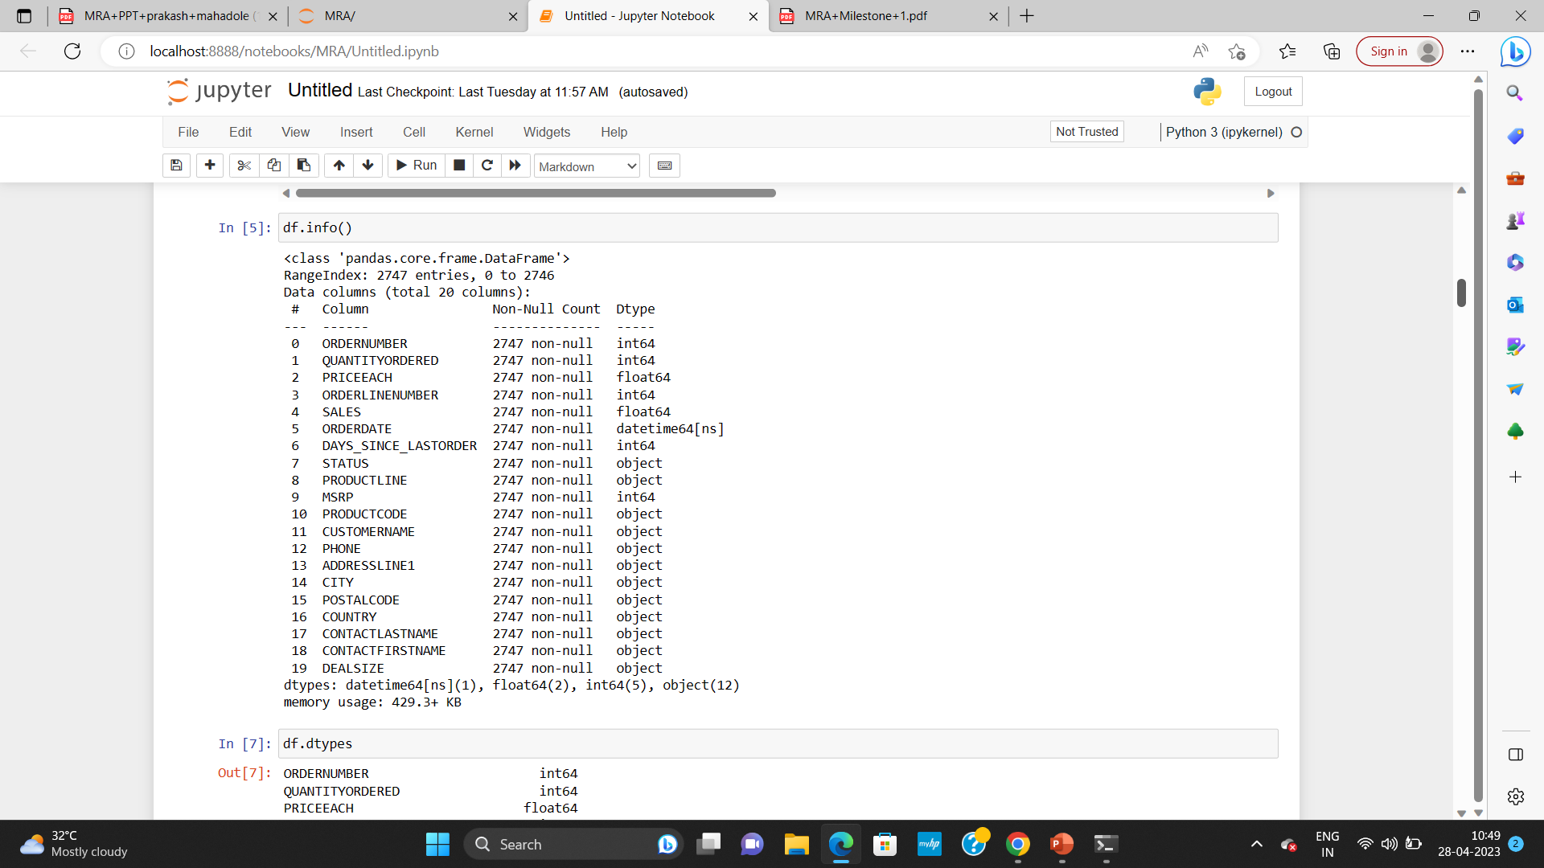
DATA ANALYSIS
The initial analysis is done using Python in Jupyter notebook.
INFO:
Dataset has 20 variables where 12 are categorical, 7 numerical and 1 date field. There are no missing values and the total number of records are 2747.

Slide 5
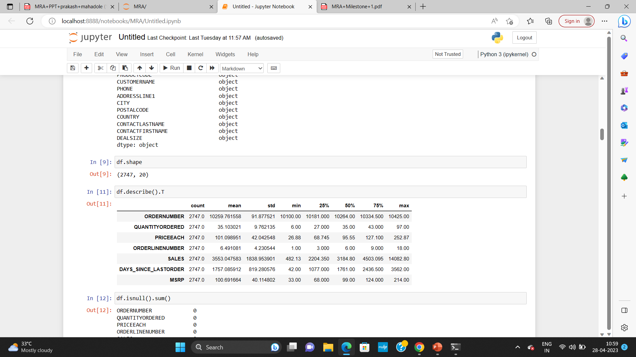
Data shape: Dataset has 2747 rows and 20 columns.
DATA INFO: Looking at the summary sheet we can assume the sales amount ranges from 482.13$ to 14082.8$ with mean and median tending to equal which meant to be normally distributed.
And even the Quantity ordered data suggests the distribution is normal .

Slide 6
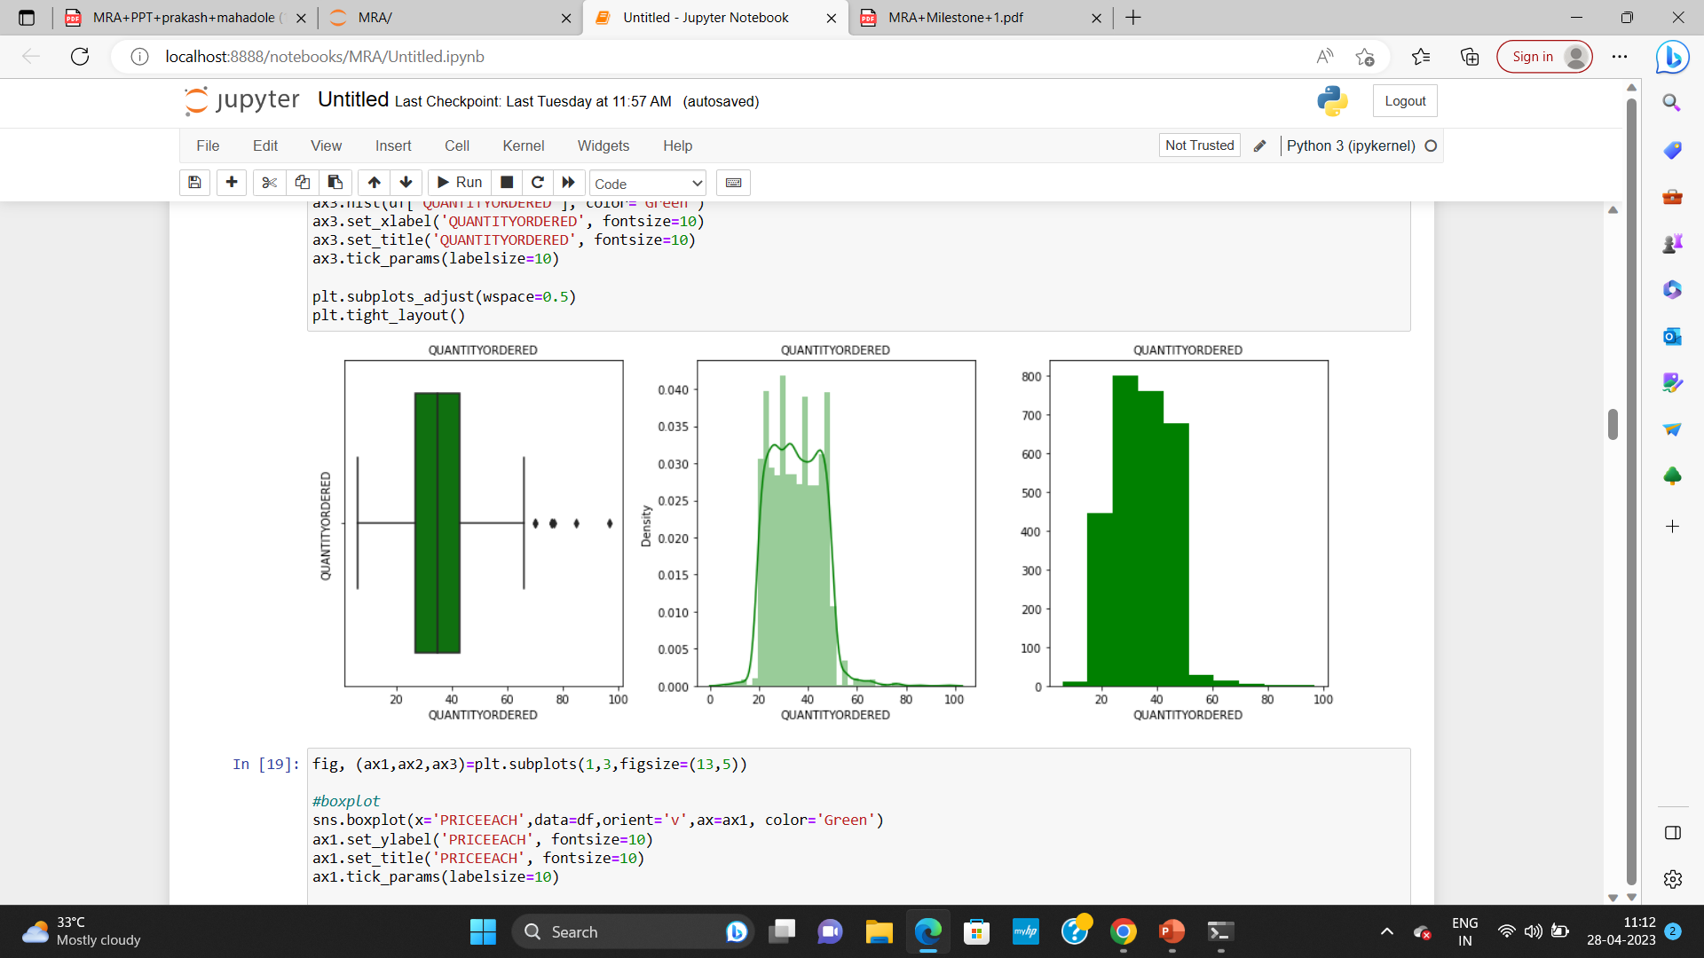
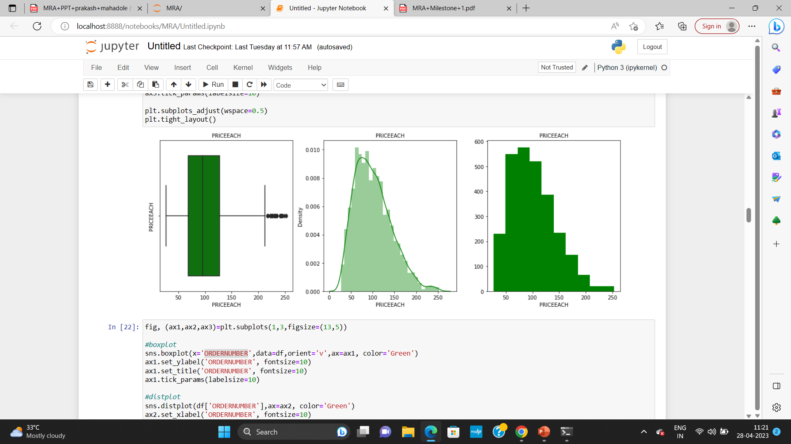
Exploratory data analysis(EDA)
Univariate Analysis: We have plotted boxplot, distplot and histogram for the variables(QUANTITYORDERED,PRICEEACH, ORDERNUMBER, SALES, MSRP)

Slide 7
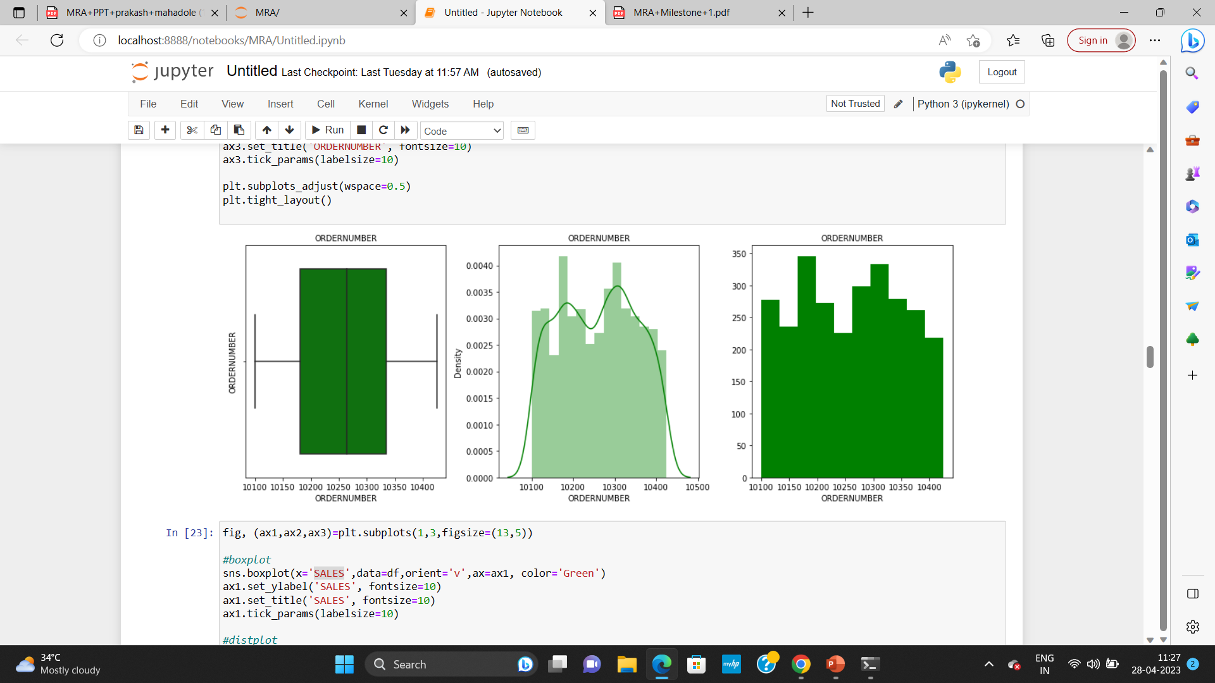
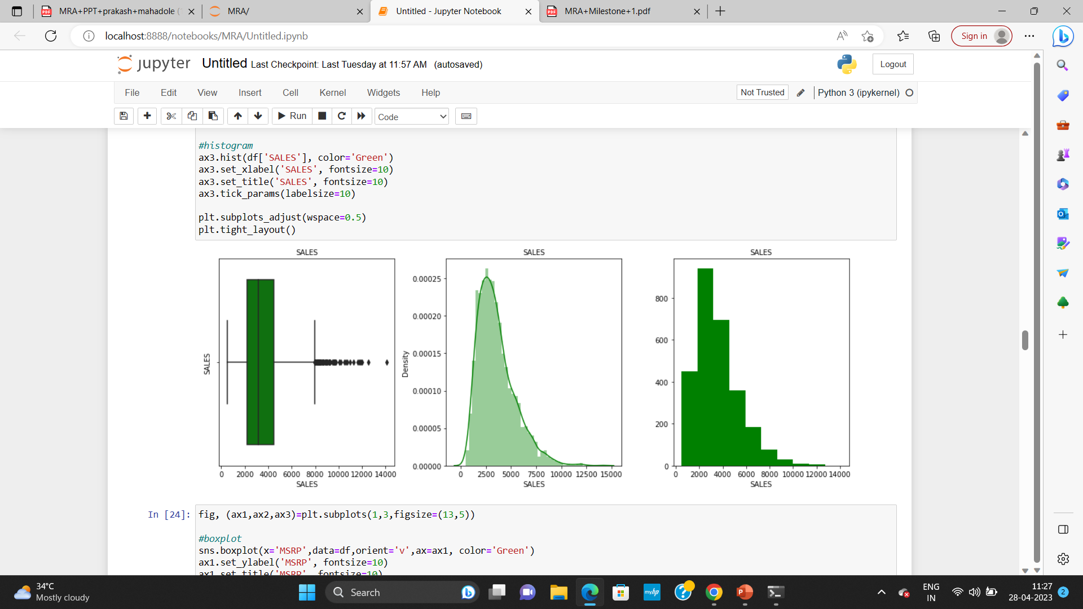

Slide 8
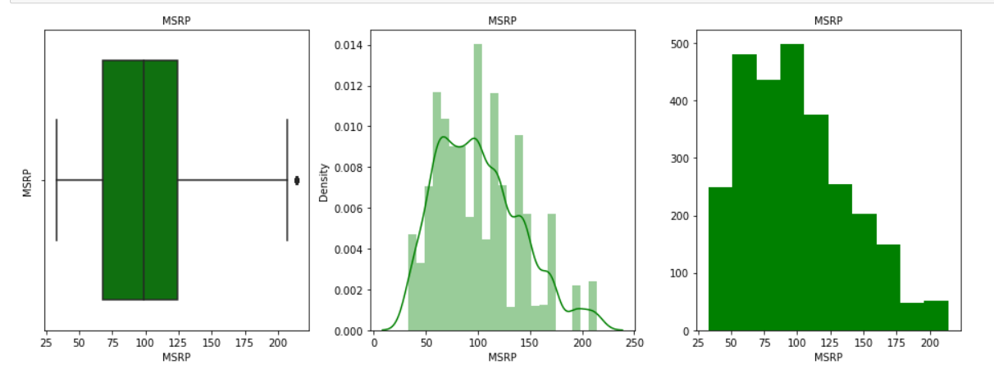
Quantity ordered has outliers present in the data and also is slightly right skewed.
Price each data is slightly right skewed and has few outliers present.
Order number does not have any outliers present in the data.
Sales is right skewed and has multiple outliers.
MSRP is also slightly right skewed and has outliers present.

Slide 9
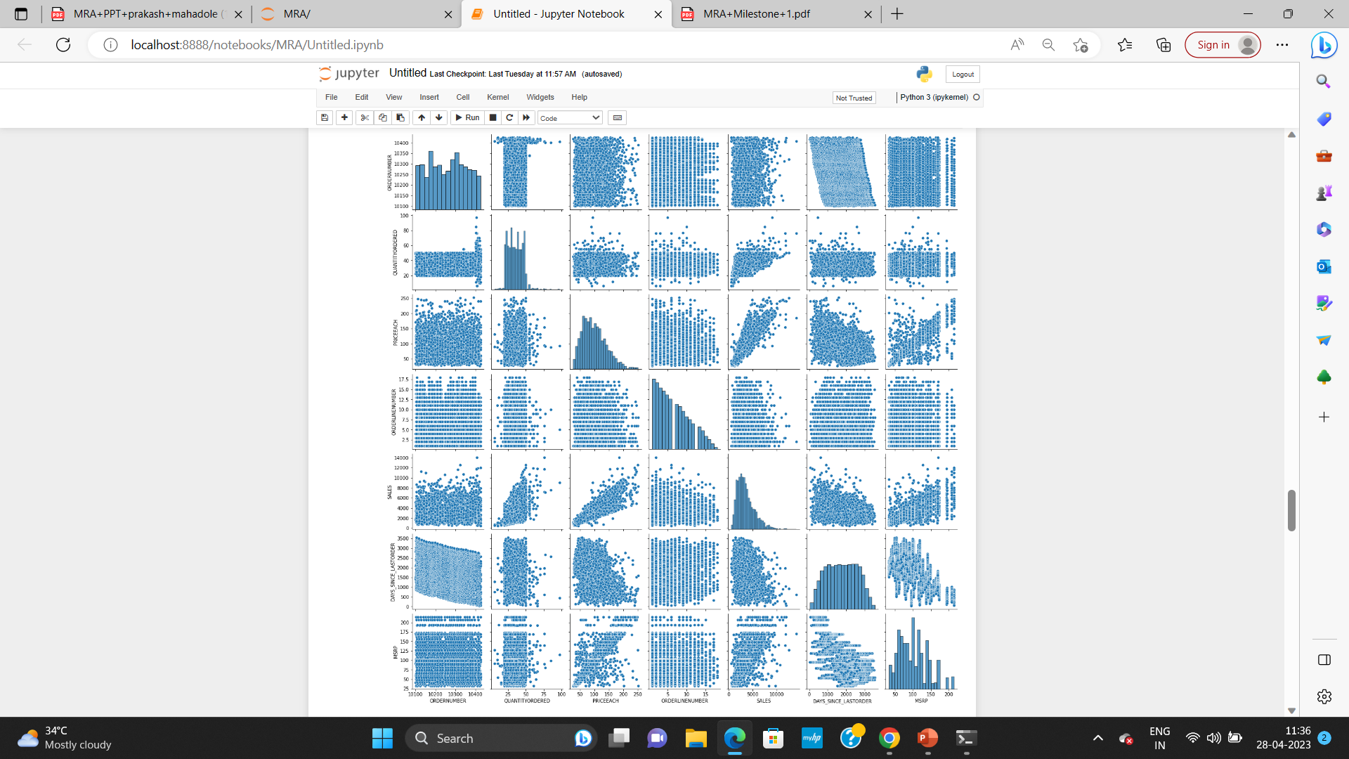
MULTIVARIATE ANALYSIS:
Creating a pairplot in Seaborn allows us to visualize the relationship between every numeric variable in the dataset at once

Slide 10
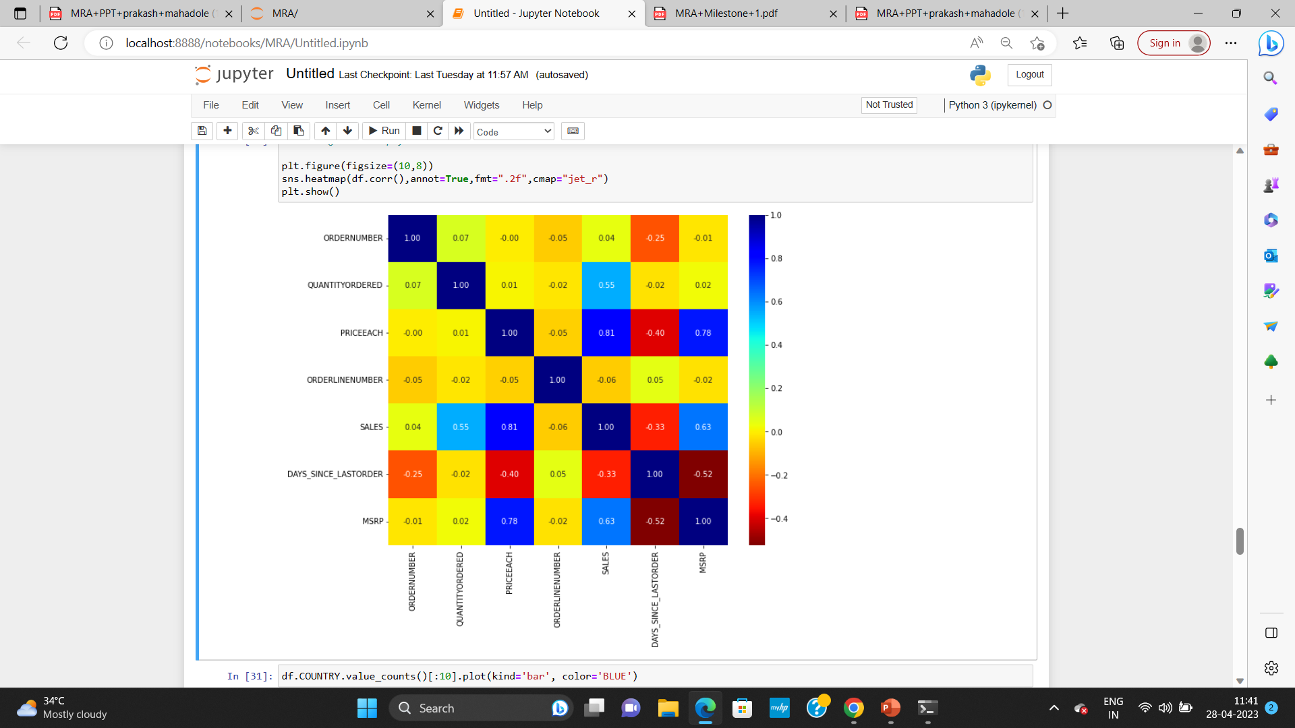
CORRELATION HEATMAP: A correlation heatmap is a graphical tool that displays the correlation between multiple variables as a color-coded matrix. SALES and PRICEEACH shows the high correlation . Also variable MSRP and PRICEEACH have a high correlation shown in above heatmap.

Slide 11
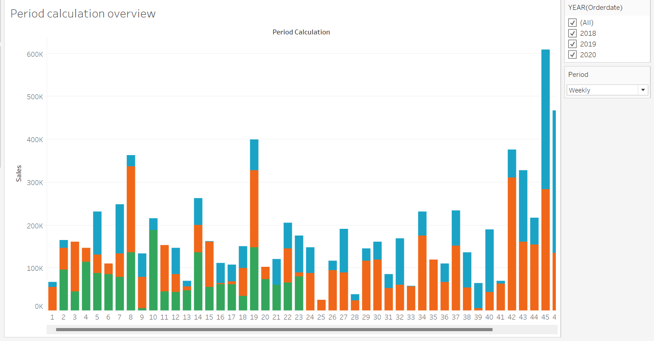
WEEKLY TREND IN SALES VARIABLE

Slide 12
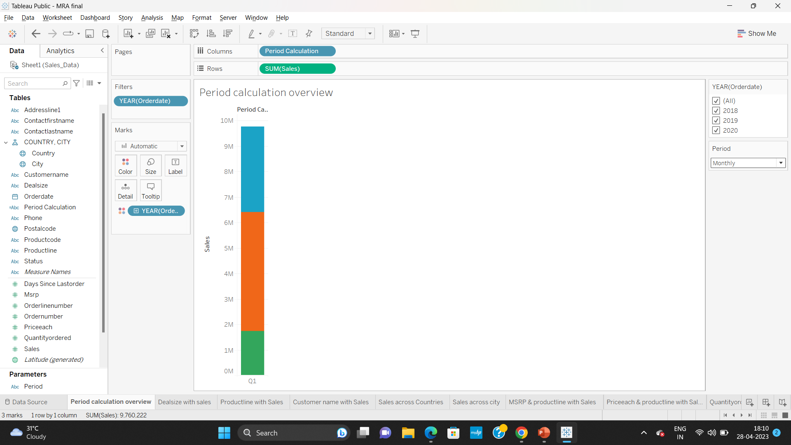
MONTHLY TREND IN SALES VARIABLE

Slide 13
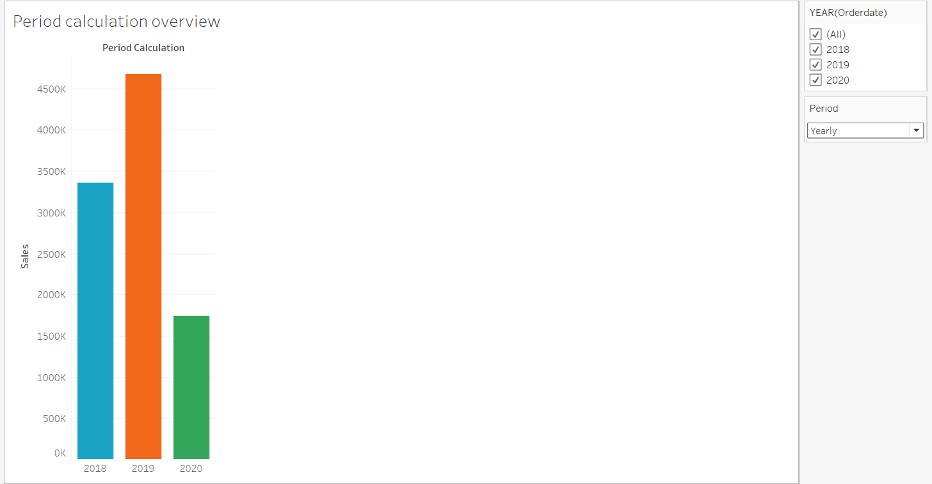
YEARLY TREND IN SALES VARIABLE

Slide 14
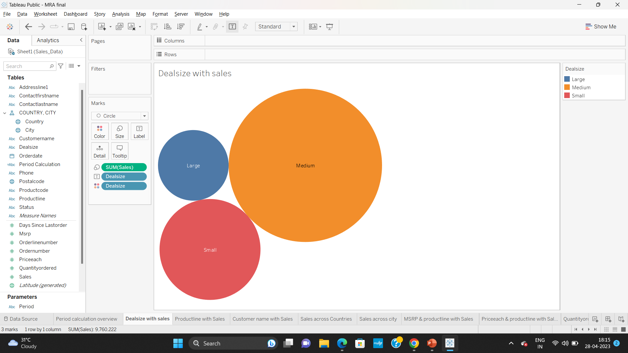
SALES ACROSS DIFFERENT CATEGORIES OF DIFFERENT FEATURES IN THE GIVEN DATA SALES VS DEALSIZE

Slide 15
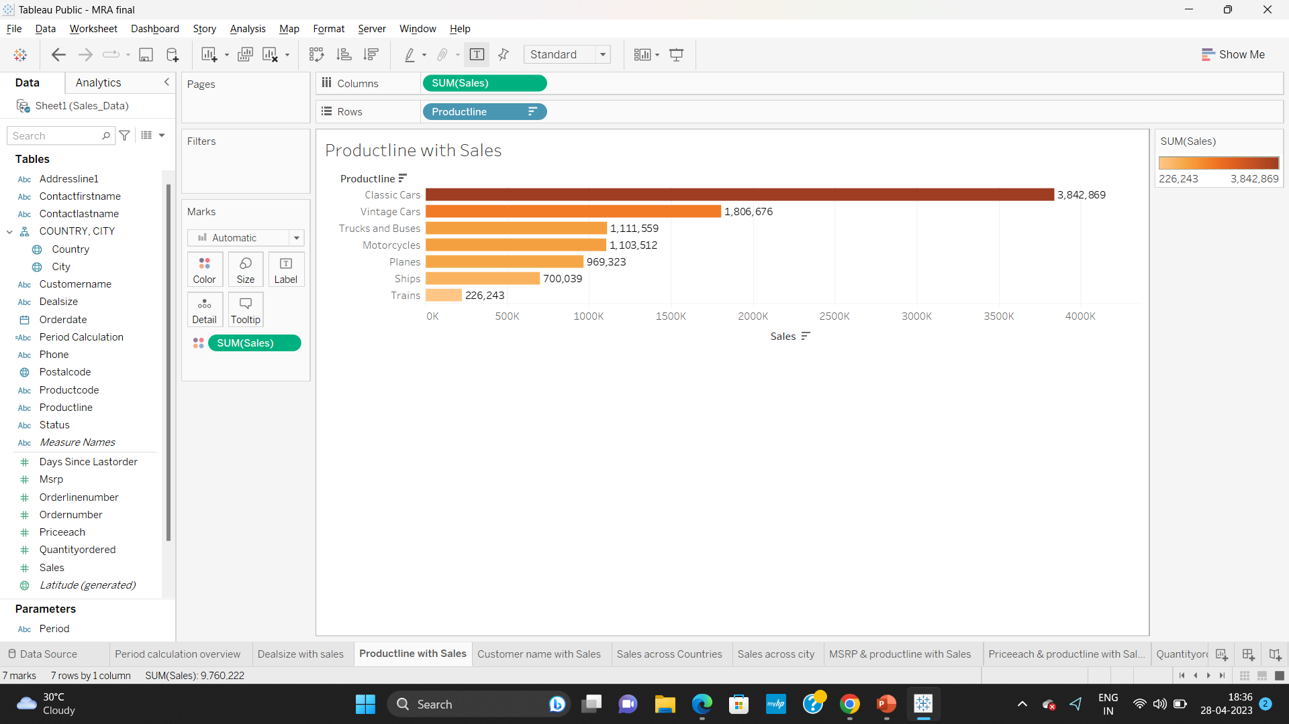
SALES VS PRODUCTLINE
Most sales and products have been ordered in Medium deal size with 5,931,231sales out of which Classic cars are having the highest sales.
The sales of product line like Trucks/Busses and motorcycles is in saturation stage.

Slide 16
INFERENCE FROM THE ABOVE ANALYSIS:
Company that have higher amount of Sales is USA as compare to other countries.
City Madrid in Spain has the highest sales and quantity ordered when compared to cities
Classic cars and Vintage cars are the highest quantity ordered with highest sales.
Trains with least quantity ordered with least sales.
The sales of large size deals remain stagnant over the years and it can be presumed that the company should focus on getting large size projects.
The EDA and visualization is done using the Tableau tool. The link for the same is :
https://public.tableau.com/app/profile/barkha.agarwal/viz/MRAfinal_16824879540720/CustomernamewithSales

Slide 17
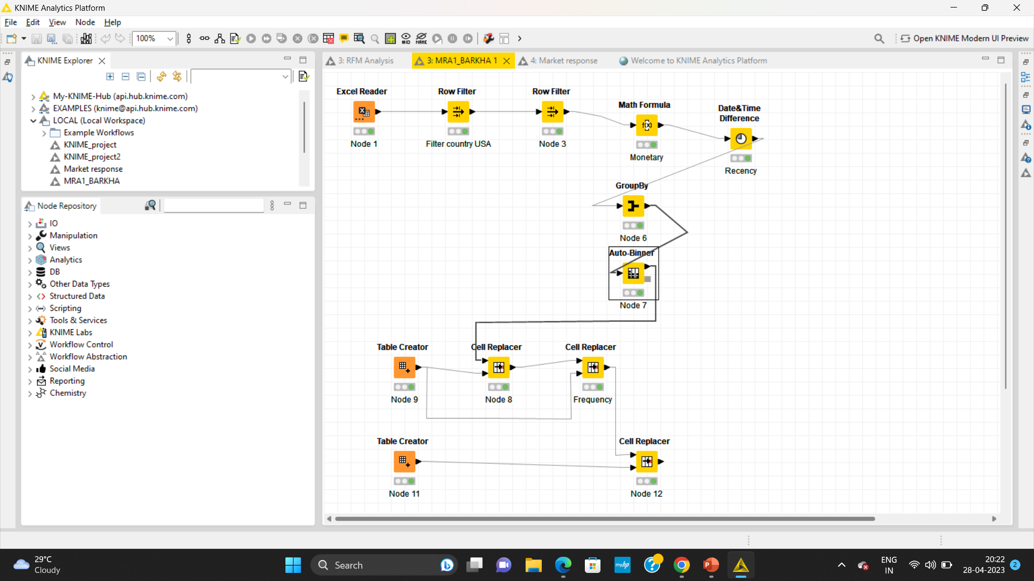
WORKFLOW IMAGE OF KNIME

Slide 18
CUSTOMER SEGMENTATION USING RFM ANALYSIS
The tool used for Customer segmentation using RFM analysis is knime .
We have used country column for recency analysis and chosen country as USA.
We have created 4 segments
Low
Medium
High
Extremely high
After performing RFM analysis, it was found that Recency consists of top 25% customer which can be termed as active customers.
Bin-3 consist of customers which are at risk.
After that the bottom consists of inactive customers which are in Bin-4 and in lowest quartile.

Slide 19
INFERENCES FROM RFM ANALYSIS AND IDENTIFIED SEGMENTS
Top 5 best Customers are :
1.Customer “Mini Gifts Distributors” having large type dealsize with a high monetary value , high frequency and high recency . This is the best customer.
2.We have our second best customer “Muscle Machine Inc.” with medium monetary, medium frequency and high recency.
3. The third one is “Land of Toys Inc.” with high recency, medium frequency .
We have found only best 3 customers.
Customers who are in the verge of churning are:
1.Collectable Mini Designs Co.
2.Signal Collectibles Ltd.
3.West Coast Collectables Co.

Slide 20
Lost Customers :
Customer “Collectable Mini Design” have a medium recency, low frequency and low monetary.
Customer “Signal Collectibles Ltd.” have a medium recency, low frequency and low monetary.
Customer “West Coast Collectable” have a medium recency, low frequency and low monetary.
These are the lost customers having low recency , low frequency and low monetary
Loyal Customers:
1. Customer “Mini Gifts Distributors” having high monetary, high frequency and high recency .
2. Customer “Muscle Machine Inc.” with medium monetary, medium frequency and high recency.
3. Customer “Land of Toys Inc.” with high recency, medium frequency.

Slide 21

RECOMMENDATIONS
According to RFM analysis, customers can be categorized into four distinct groups: best, loyal, verge of churn, and lost customers. It is important to develop a focused approach for each group in order to optimize customer retention and enhance customer experience.
best customers, it is recommended to provide personalized recognition, exclusive offers, and incentives to ensure that they continue to choose our company over others. By doing so, we can maintain their loyalty and strengthen the long-term relationship.
loyal customers, it is essential to offer periodic discounts and offers to keep them engaged and interested in our products or services. By keeping them engaged, we can turn them into our best customers and improve their satisfaction level with our brand.
verge of churn customer, we need to develop an effective action plan to prevent them from leaving the company. We can conduct surveys, offer incentives, and personalize the communication to identify and address their concerns, and thereby increase their loyalty towards our brand.
lost customers, it is important to analyze their behavior and preferences to identify the reasons for their departure. By identifying the key drivers of customer churn, we can develop targeted strategies to prevent such occurrences in the future and improve our overall retention rate.

Slide 22
THANK YOU

